Slide 1
Lecture 18 - Principal Component Analysis
DS 4400: Machine Learning and Data Mining 1

Slide 2
Today
Principal Component Analysis (PCA)

Slide 3
What is Principal Component Analysis (PCA)
PCA is a dimensionality reduction technique used to transform a high-dimensional dataset into a lower-dimensional one while retaining as much of the original variance (information) as possible.
PCA works by finding new axes (directions) in the data space, called principal components, along which the data varies the most.
For this, PCA uses covariance matrix of the data and its eigenvalues and eigenvectors of that matrix.

Slide 4
Step-by-Step Application of PCA
Start with centered data
Subtract the mean from each feature so the dataset has a mean of zero.
Compute the Covariance Matrix, Σ
The matrix Σ expresses how features vary with each other
Find the Eigenvalues and Eigenvectors of Σ
The eigenvectors of Σ point in the directions of maximum variance.
The corresponding eigenvalues tell you how much variance is along each of those directions.
Sort by Eigenvalues
Larger eigenvalues = more variance = more "important" directions.
Sort eigenvectors by descending eigenvalues.
Project Data onto the Top k Eigenvectors
Select the top k eigenvectors (principal components) to reduce the data to k-dimensions.
New data = original data projected onto those eigenvectors

Slide 5
Step-by-Step Application of PCA
Start with centered data
Subtract the mean from each feature so the dataset has a mean of zero.
Compute the Covariance Matrix, Σ
The matrix Σ expresses how features vary with each other:
Find the Eigenvalues and Eigenvectors of Σ
The eigenvectors of Σ point in the directions of maximum variance; the eigenvectors are called the principal components.
The corresponding eigenvalues tell you how much variance is along each of those directions.
Sort by Eigenvalues
Larger eigenvalues = more variance = more "important" directions.
Sort eigenvectors by descending eigenvalues.
Project Data onto the Top k Eigenvectors
Select the top k eigenvectors (principal components) to reduce the data to k-dimensions.
New data = original data projected onto those eigenvectors

Slide 6
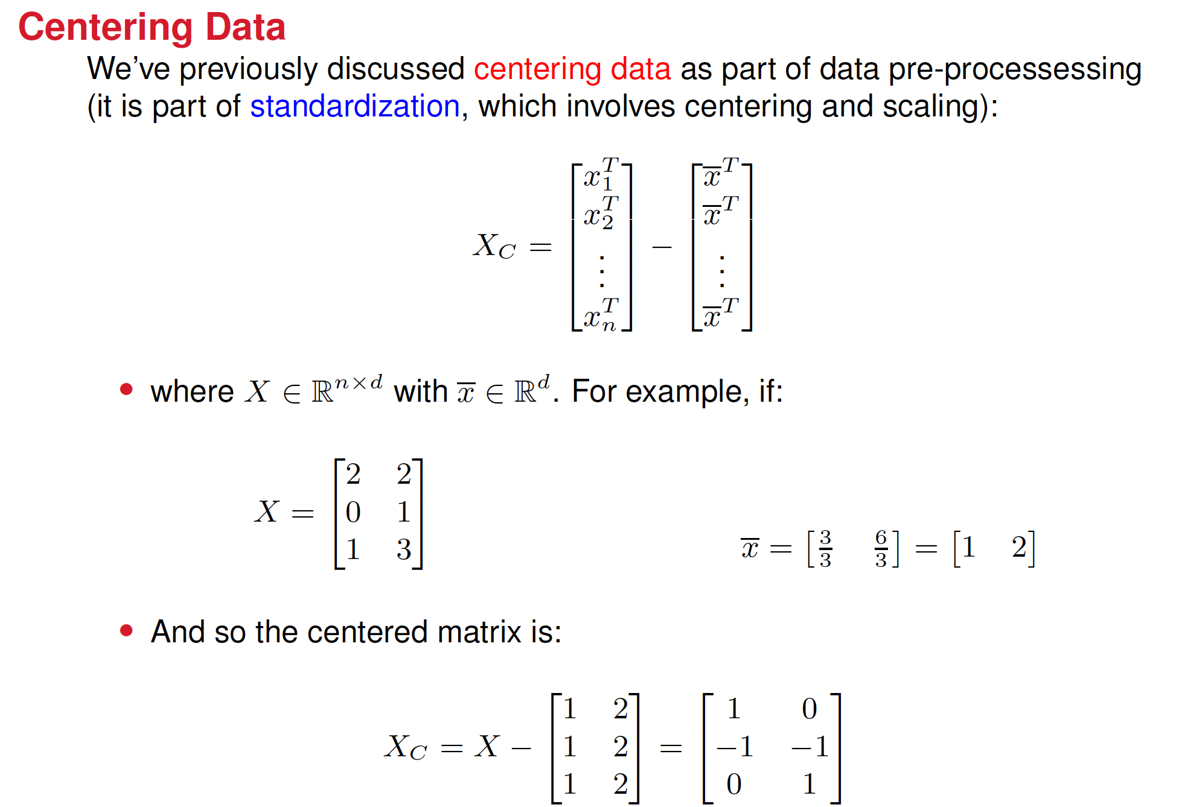













Notes:
Explain this

Slide 7
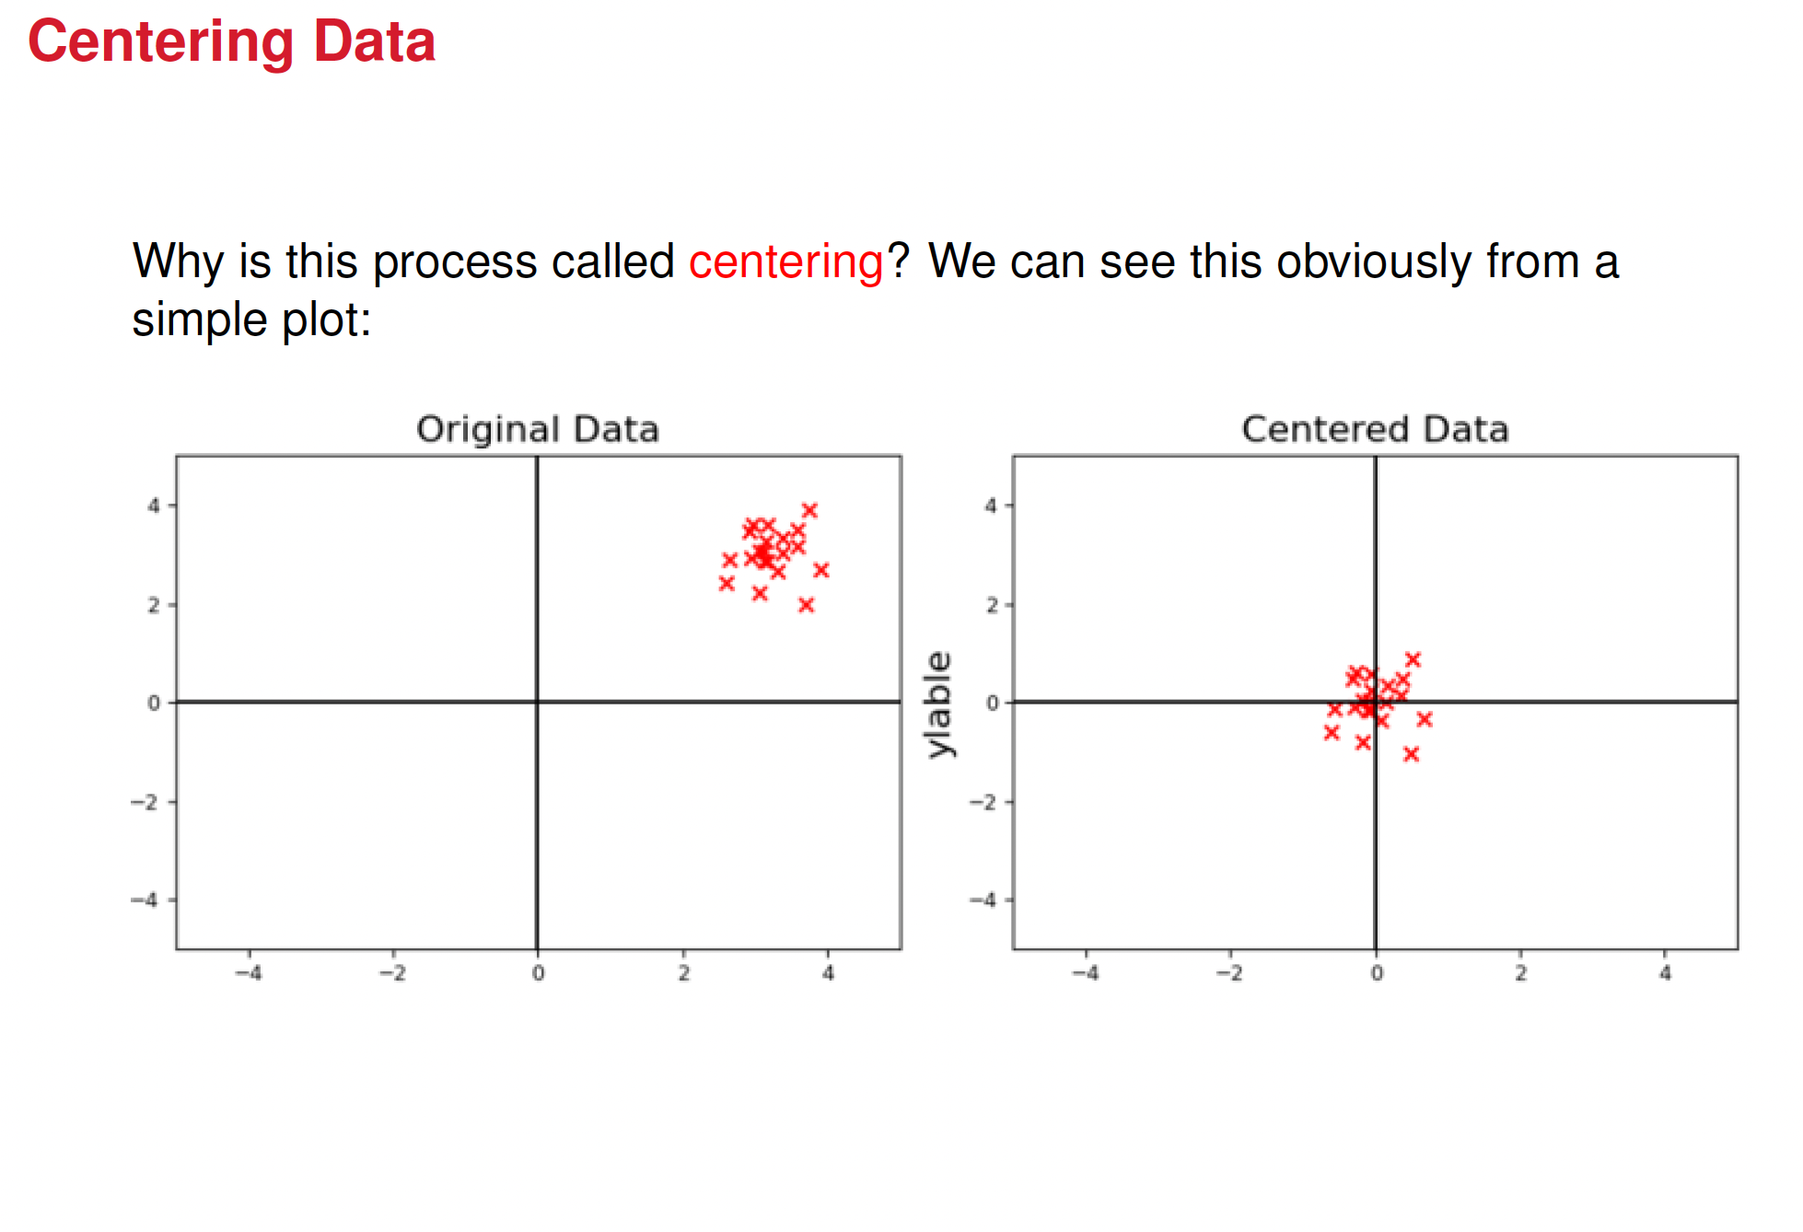

Slide 8
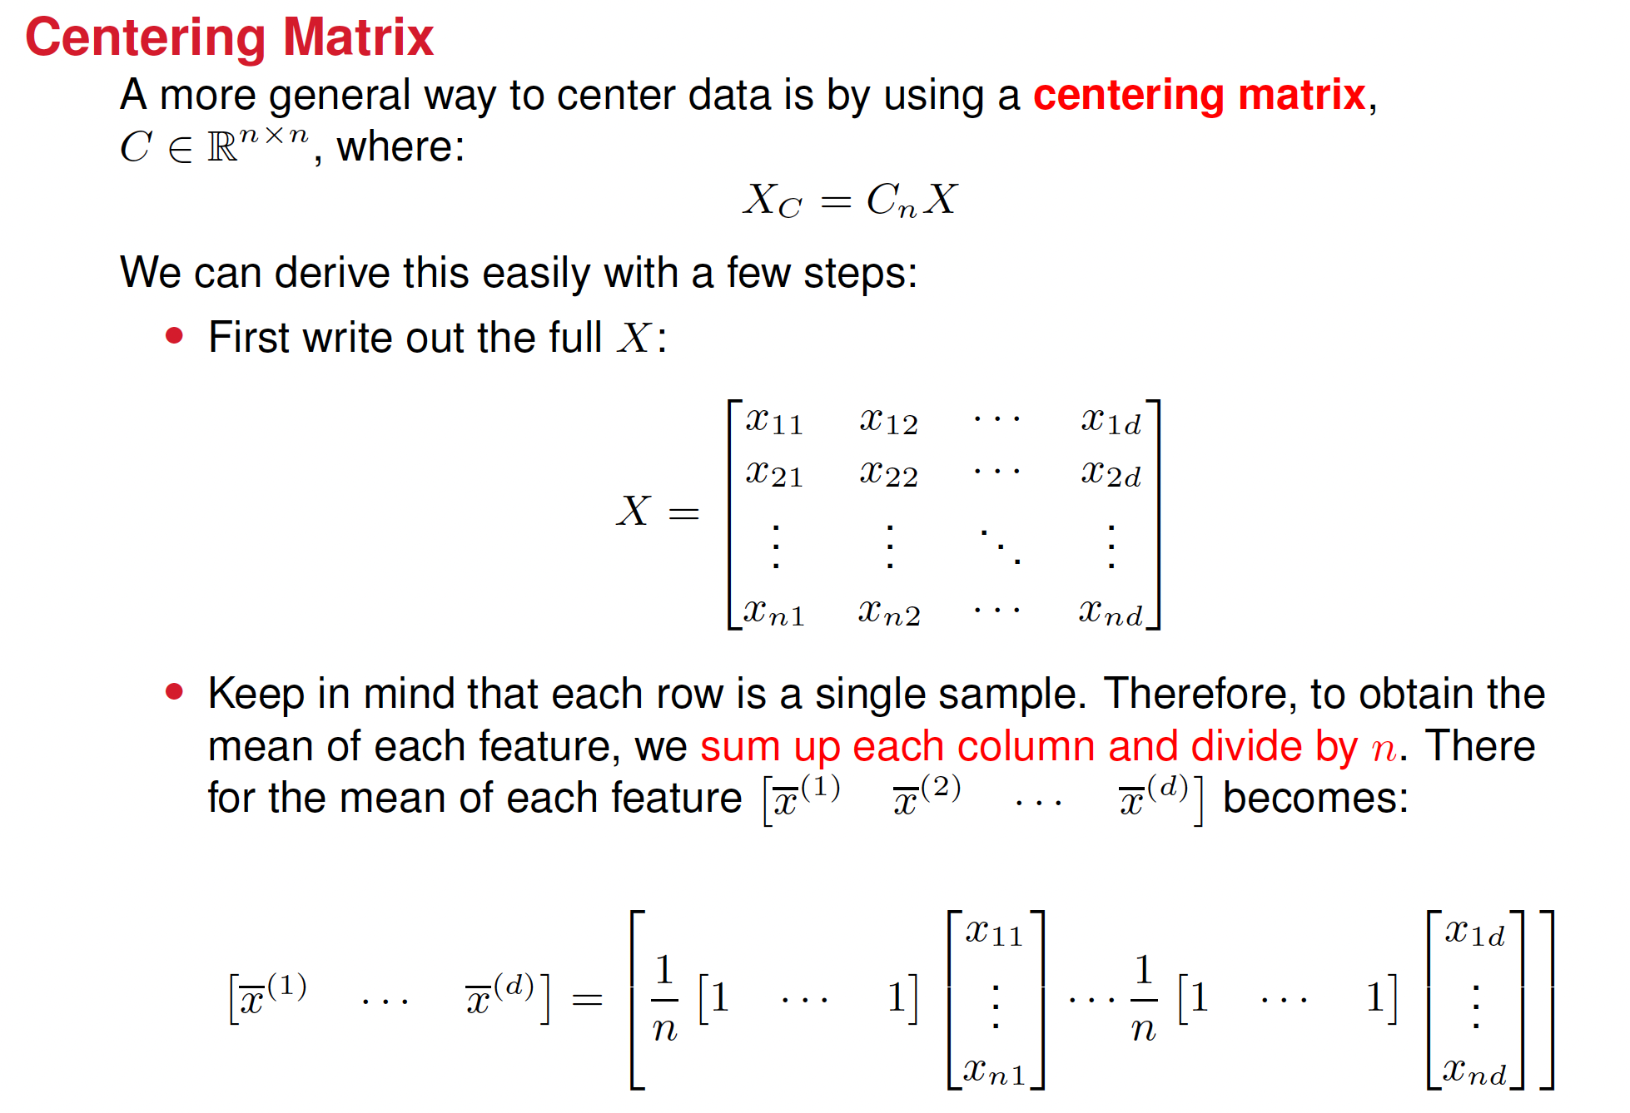






Slide 9
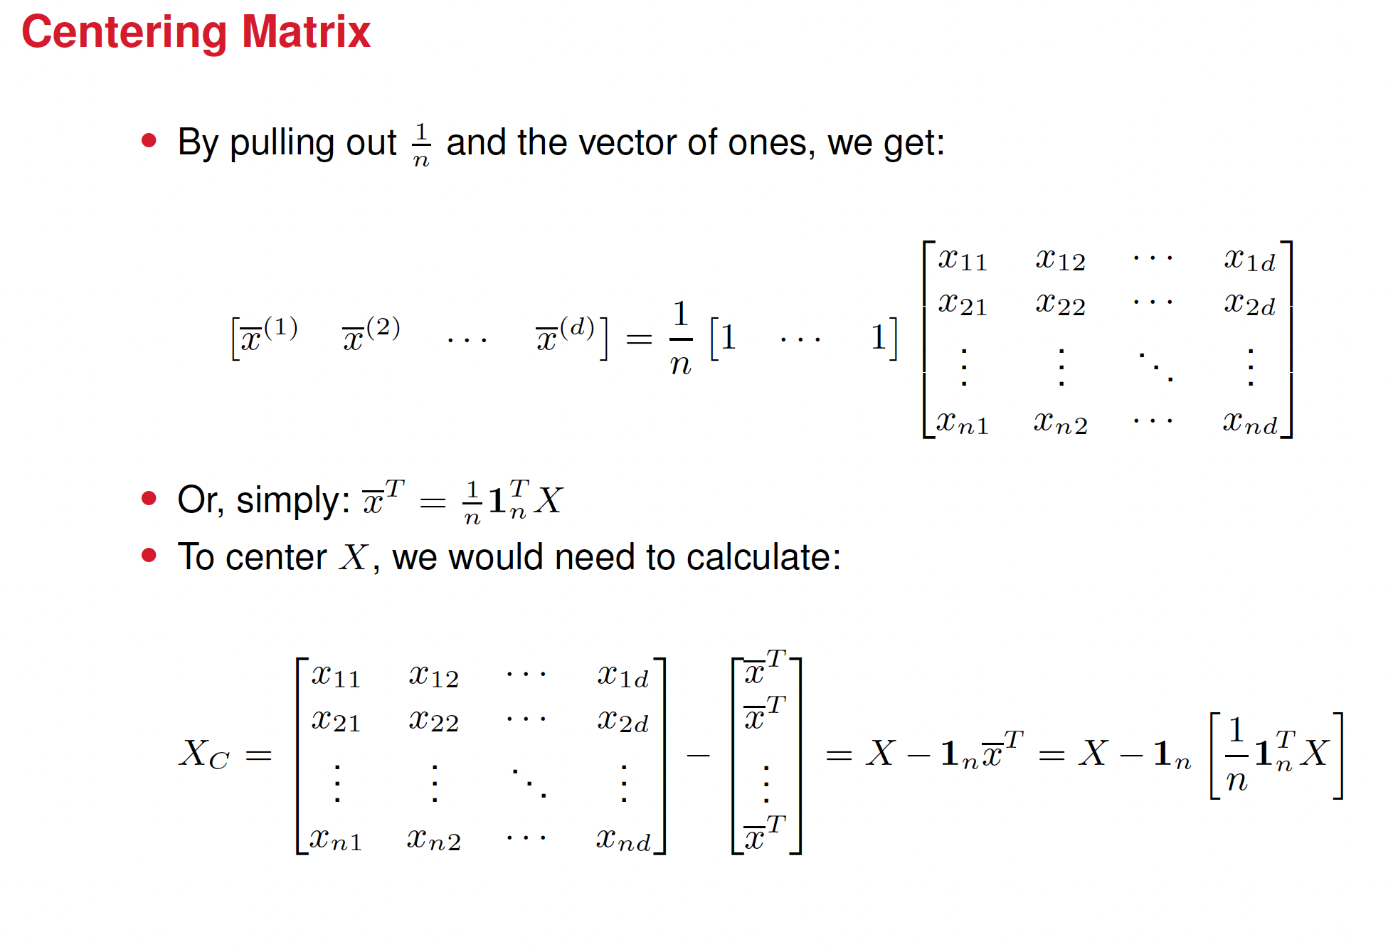
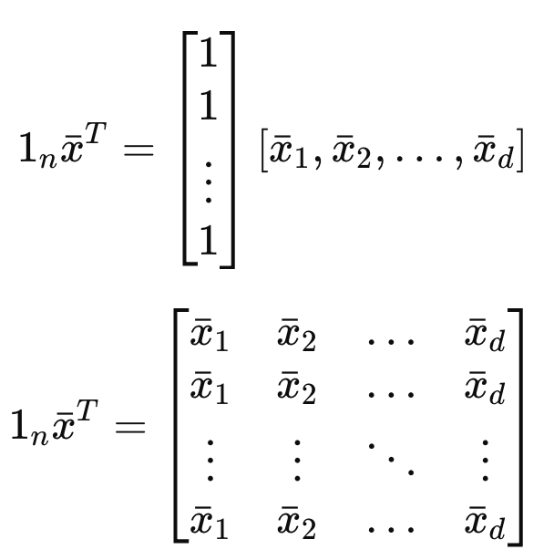










Slide 10
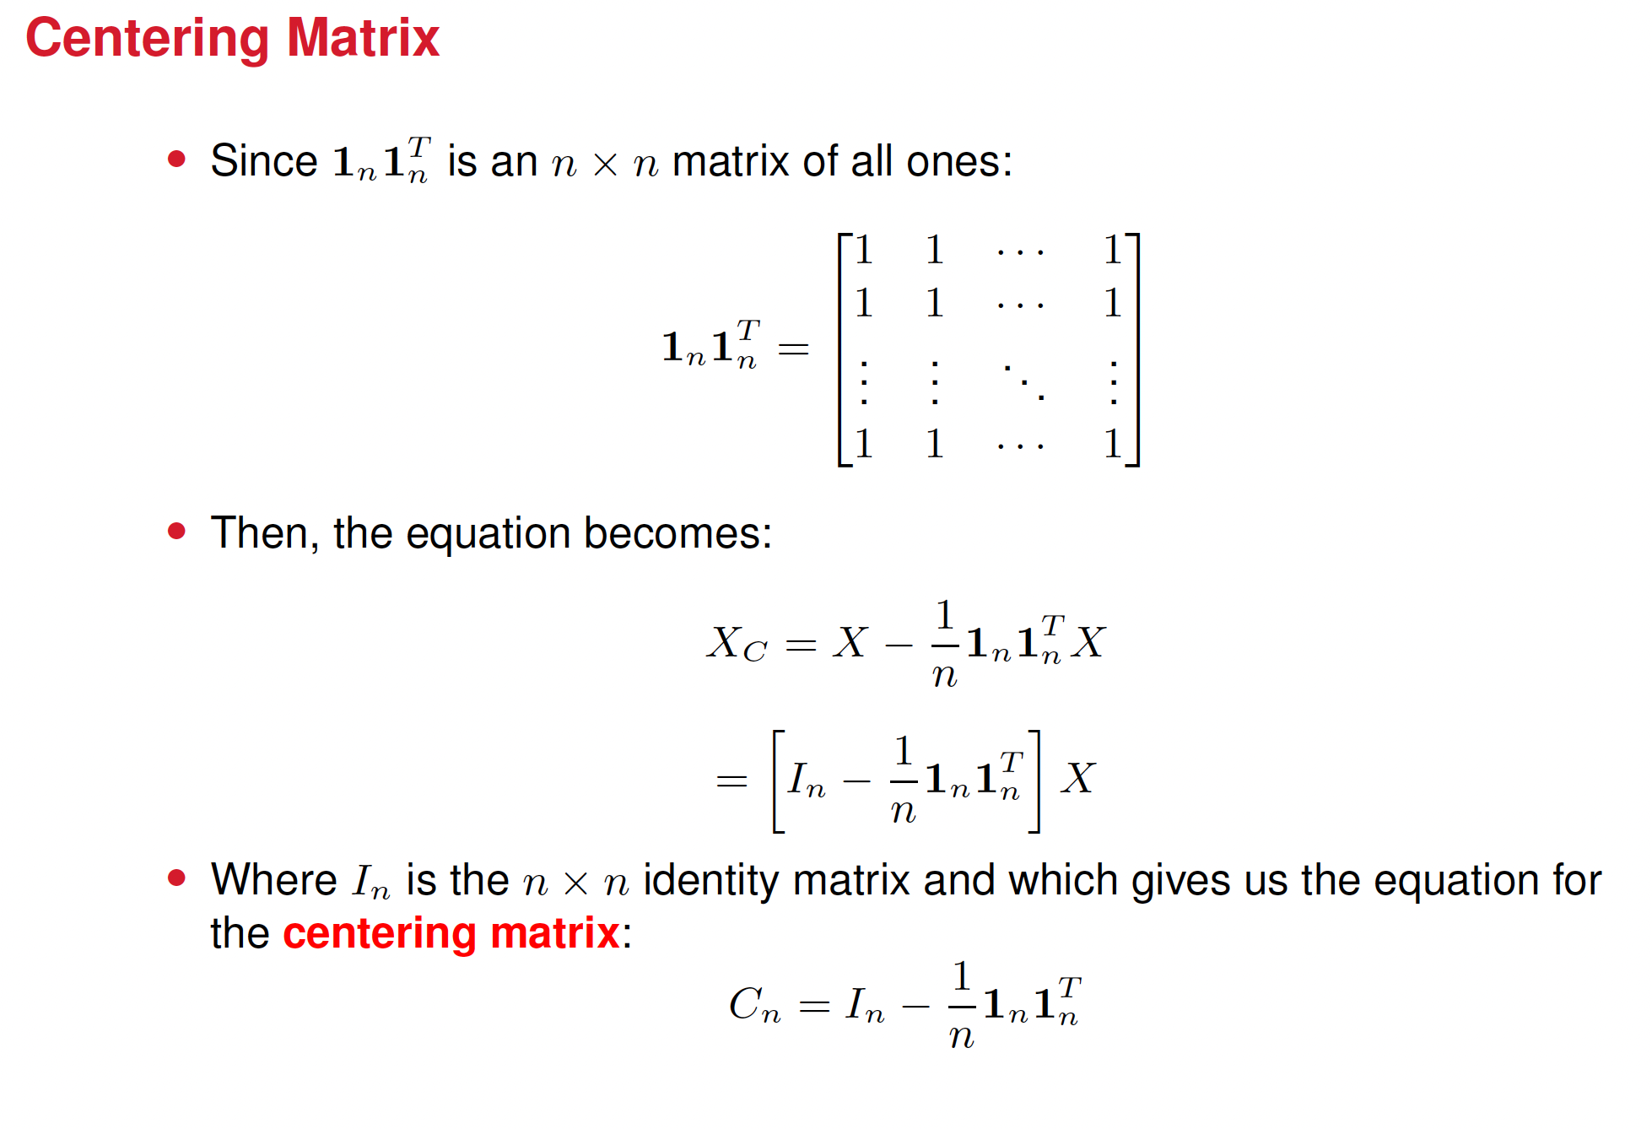
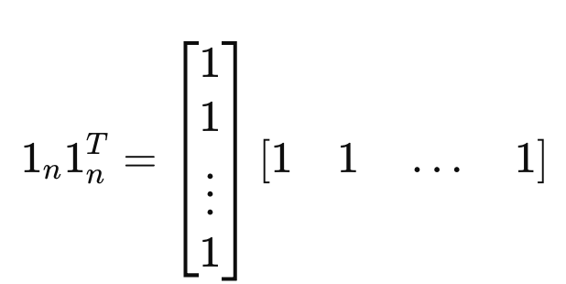



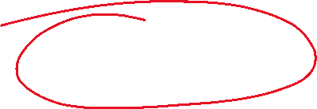


Slide 11
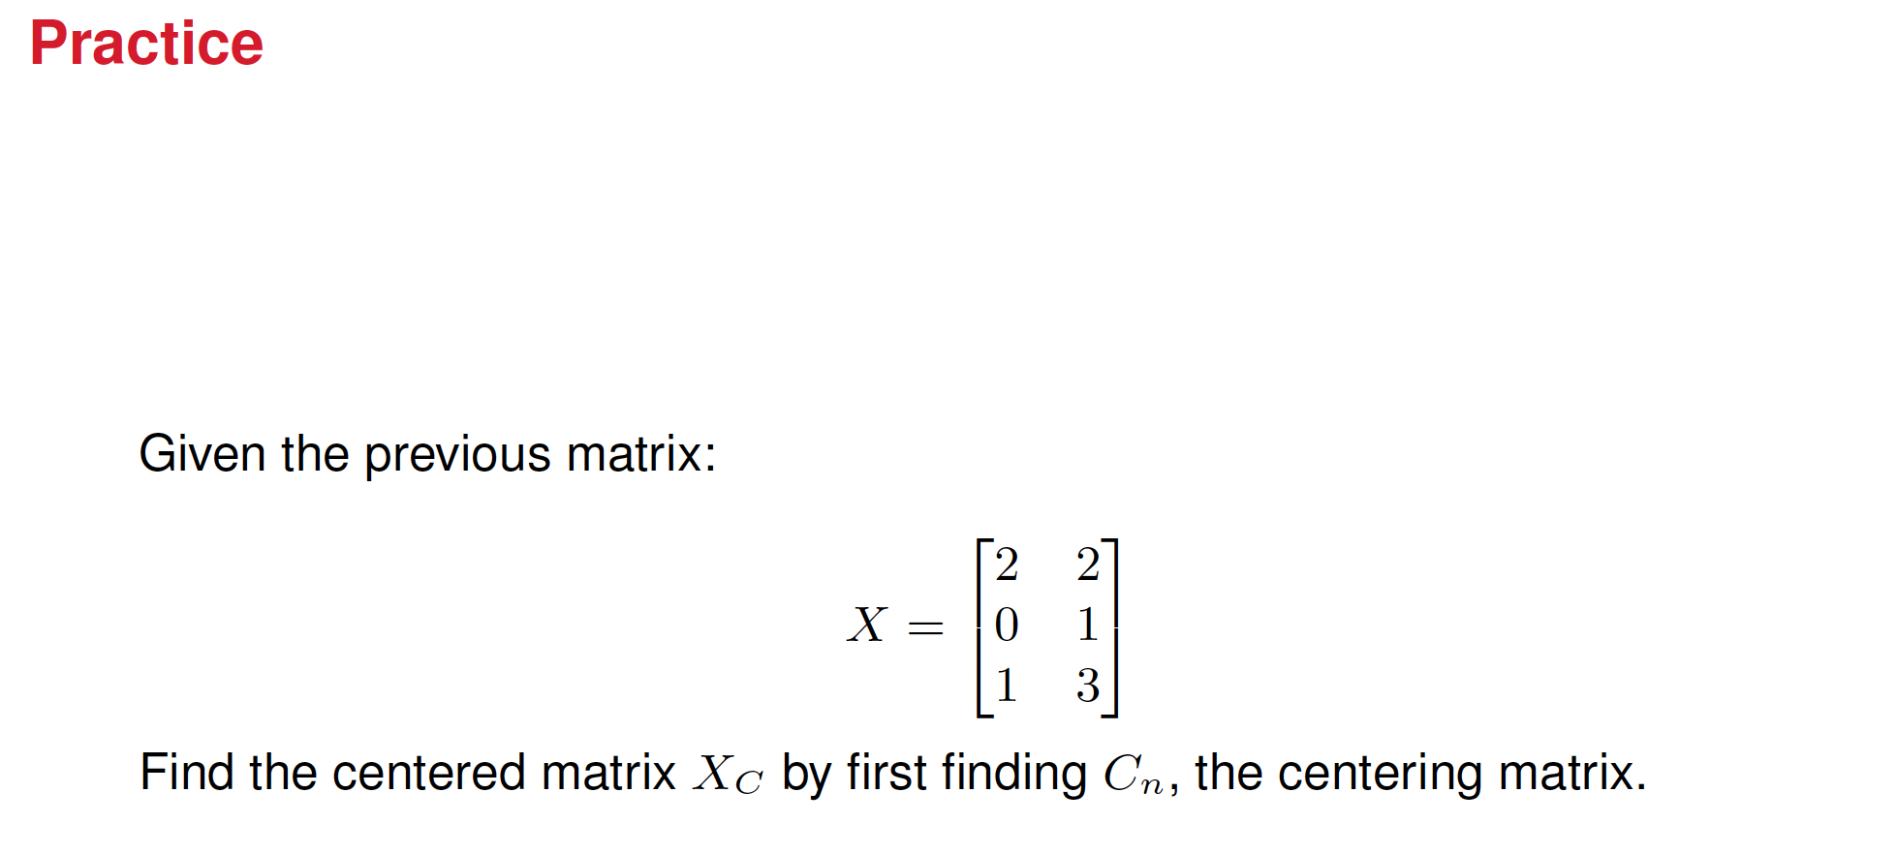
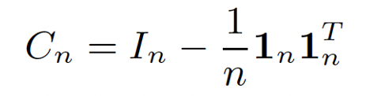


Slide 12
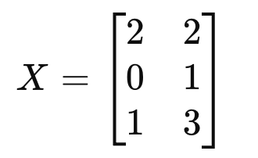
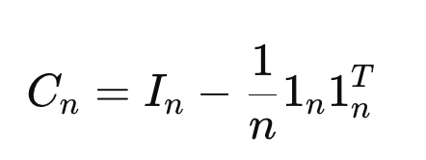
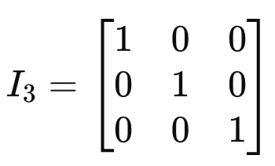
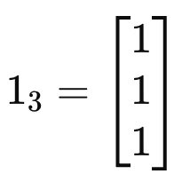
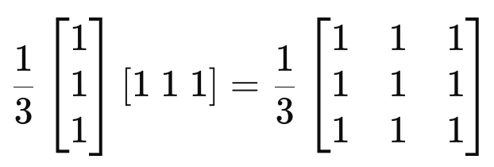

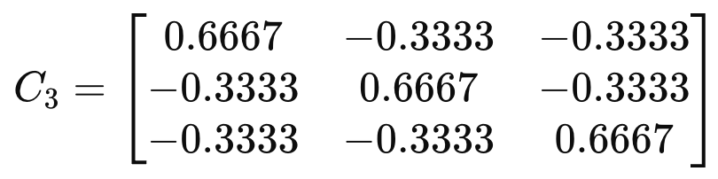
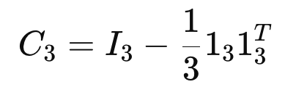
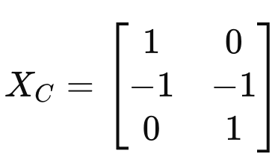





Solution

Slide 13
Step-by-Step Application of PCA
Start with centered data
Subtract the mean from each feature so the dataset has a mean of zero.
Compute the Covariance Matrix, Σ
The matrix Σ expresses how features vary with each other:
Find the Eigenvalues and Eigenvectors of Σ
The eigenvectors of Σ point in the directions of maximum variance; the eigenvectors are called the principal components.
The corresponding eigenvalues tell you how much variance is along each of those directions.
Sort by Eigenvalues
Larger eigenvalues = more variance = more "important" directions.
Sort eigenvectors by descending eigenvalues.
Project Data onto the Top k Eigenvectors
Select the top k eigenvectors (principal components) to reduce the data to k-dimensions.
New data = original data projected onto those eigenvectors

Slide 14
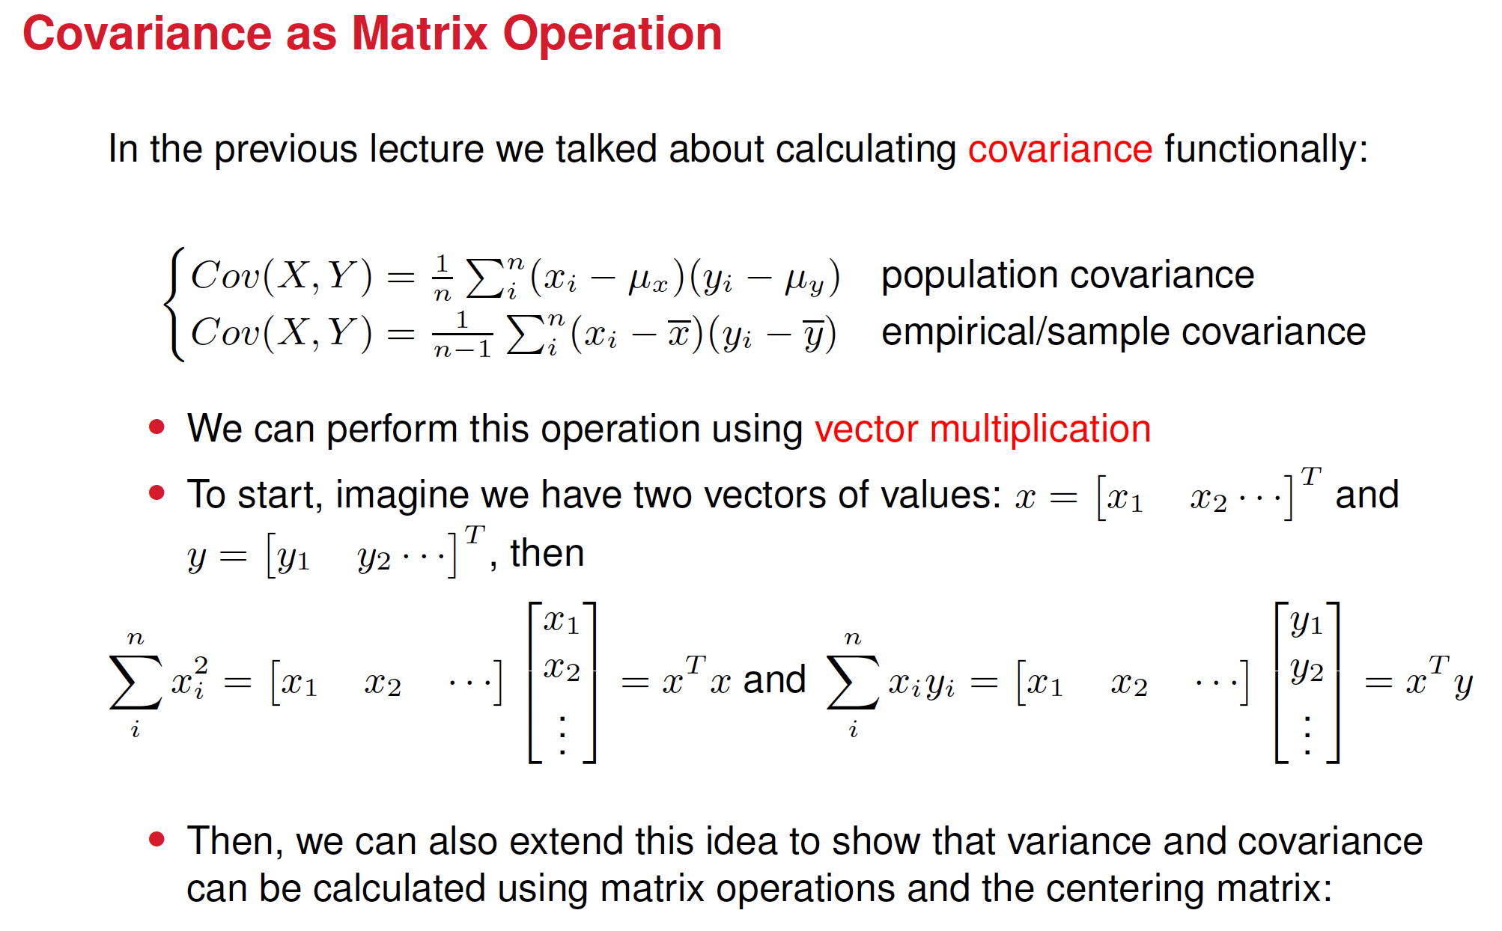

Slide 15
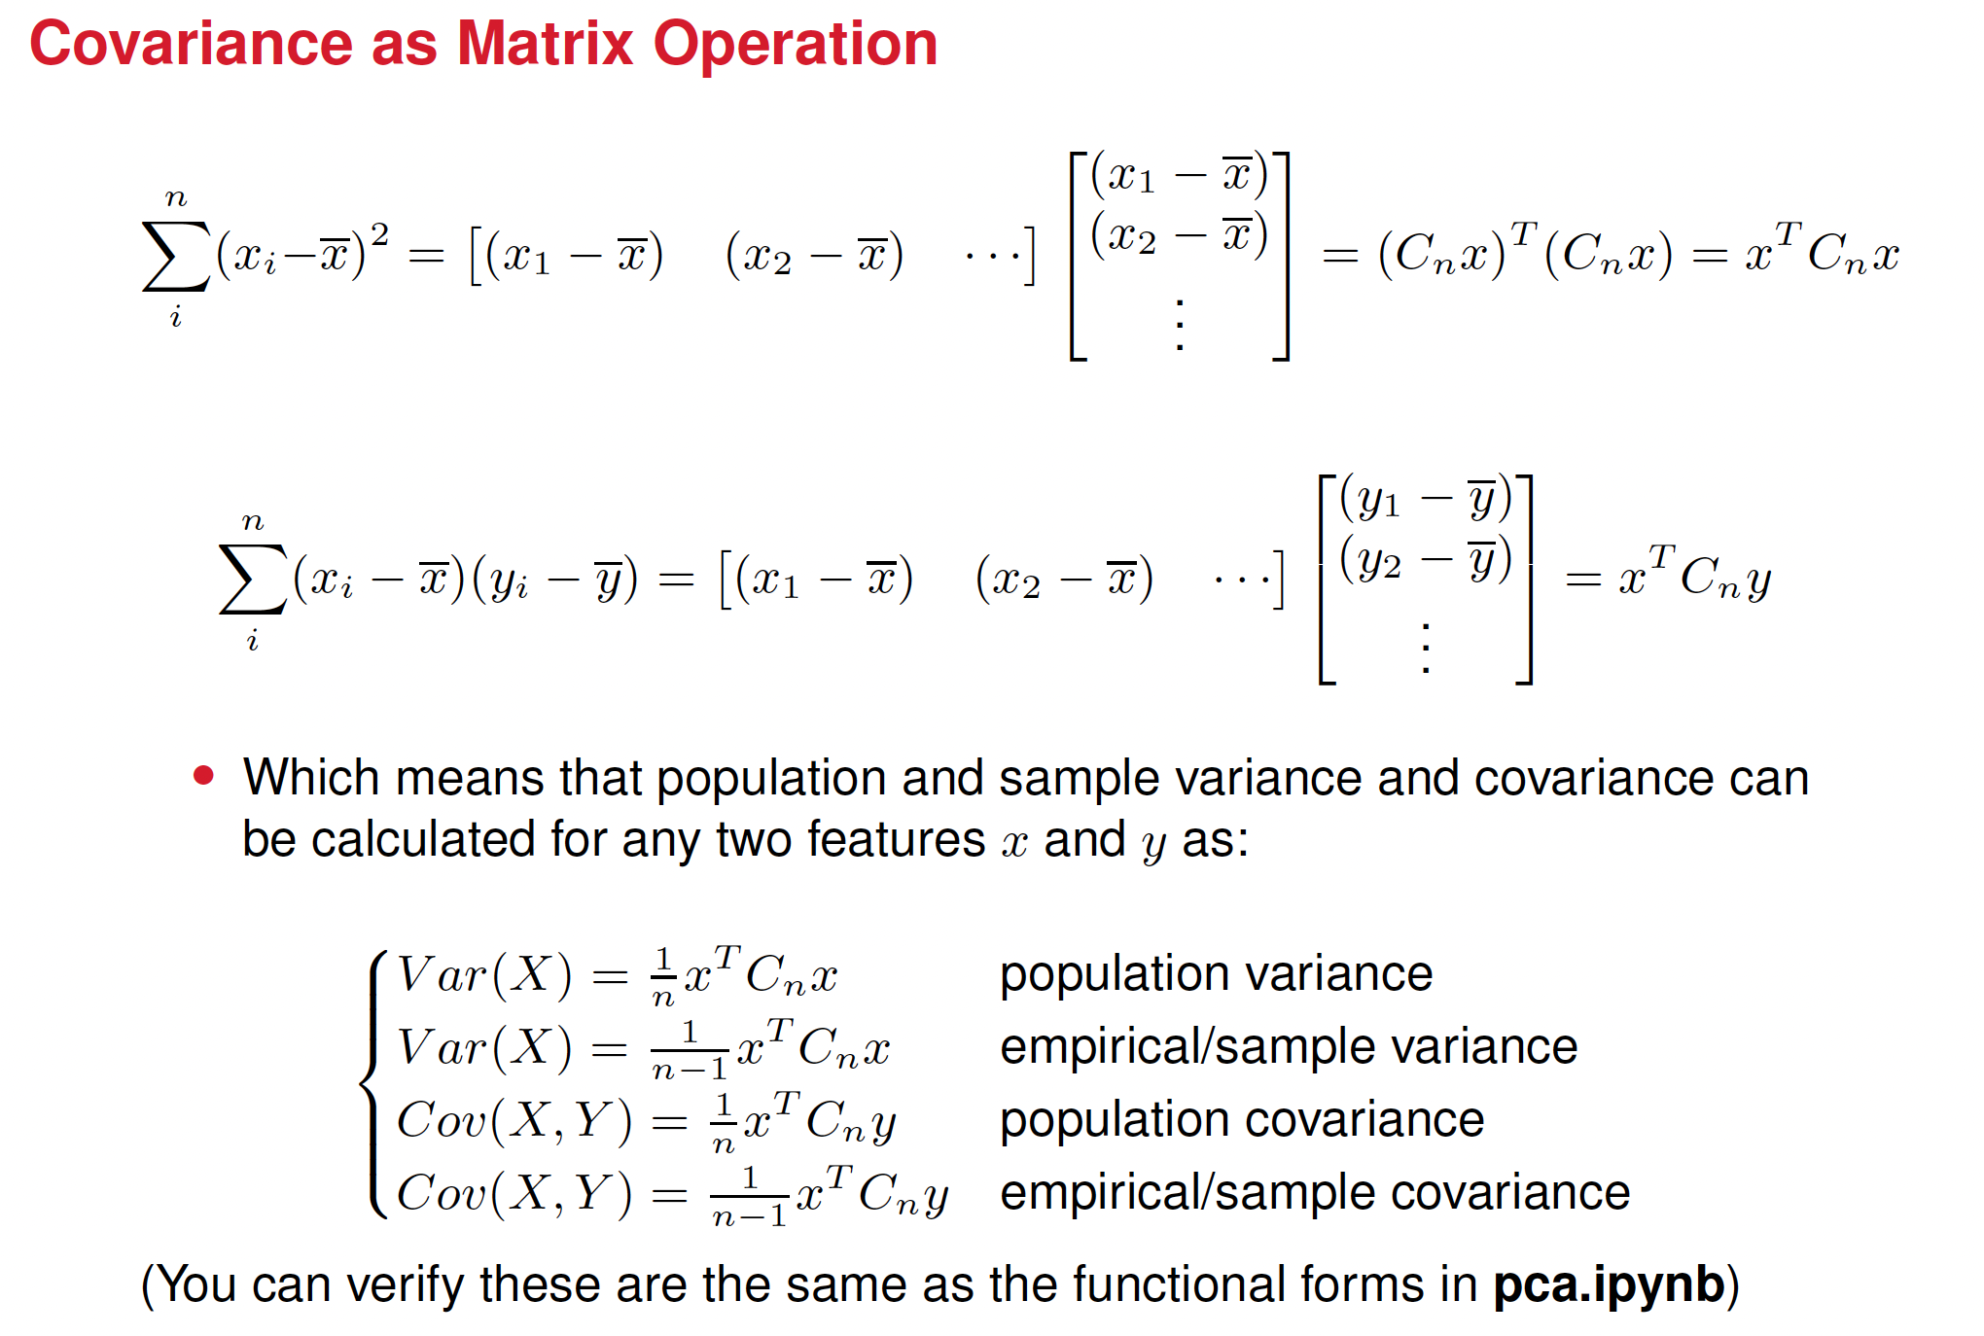








Slide 16



































Slide 17
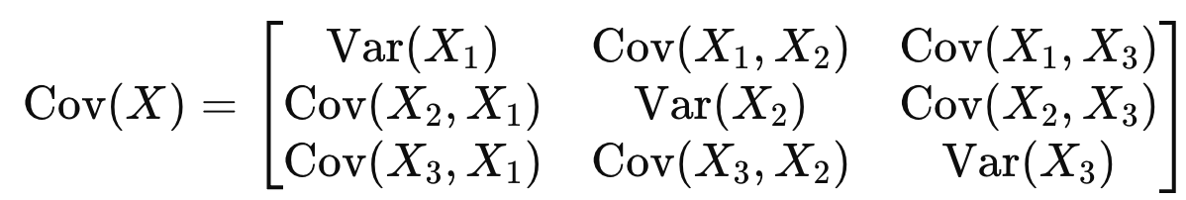









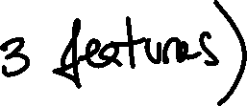
More compact expression for the covariance matrix

Slide 18




Step-by-Step Application of PCA
Start with centered data
Subtract the mean from each feature so the dataset has a mean of zero.
Compute the Covariance Matrix, Σ
The matrix Σ expresses how features vary with each other:
Find the Eigenvalues and Eigenvectors of Σ
The eigenvectors of Σ point in the directions of maximum variance; the eigenvectors are called the principal components.
The corresponding eigenvalues tell you how much variance is along each of those directions.
Sort by Eigenvalues
Larger eigenvalues = more variance = more "important" directions.
Sort eigenvectors by descending eigenvalues.
Project Data onto the Top k Eigenvectors
Select the top k eigenvectors (principal components) to reduce the data to k-dimensions.
New data = original data projected onto those eigenvectors

Slide 19



In which direction (green or red line) the data varies the most?

Slide 20












Showing the projections in each direction

Slide 21
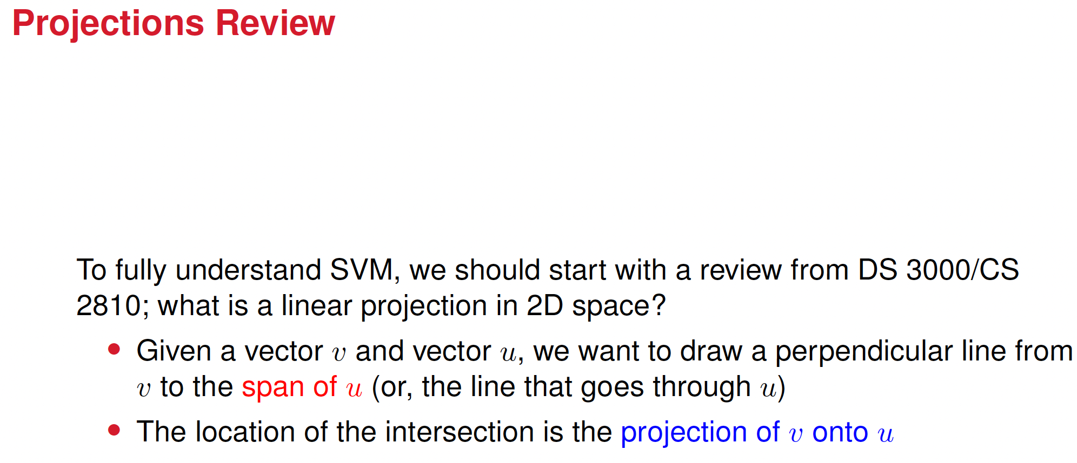






Slide 22


































Slide 23
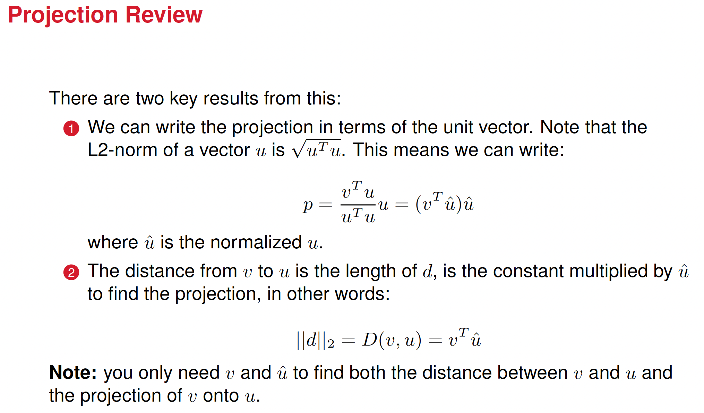






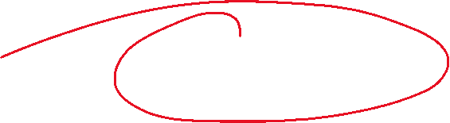











Slide 24







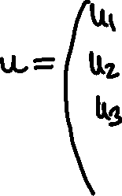




Projecting a feature matrix X onto a vector u

Slide 25



































Projecting a feature matrix X onto a vector u

Slide 26






























Now, we want to find the vectors u that, when projecting X on them,
maximize the variance of the projection

Slide 27




























Maximizing the variance of the projection

Slide 28


























Maximizing the variance of the projection

Slide 29
So what do we have so far:
We have determined the directions in the feature space along which the variance in our data is maximized
Those directions are the eigenvectors of the covariance matrix of our data. They are also called the Principal Component Axes.
The amount of variance along each eigenvector is given by its corresponding eigenvalue

Slide 30




Eigenvalues and eigenvectors
What does eigen mean? This word has a German origin, and it means, in English, proper or characteristic.
An eigenvector of a square matrix A is a non-zero vector that, when multiplied by A, results in a scaled version of itself.
An eigenvalue corresponds to the scaling factor by which the eigenvector is stretched or shrunk when multiplied by the matrix.

Slide 31
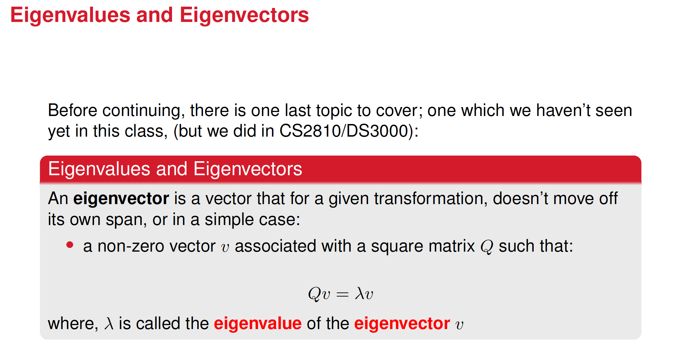

Slide 32
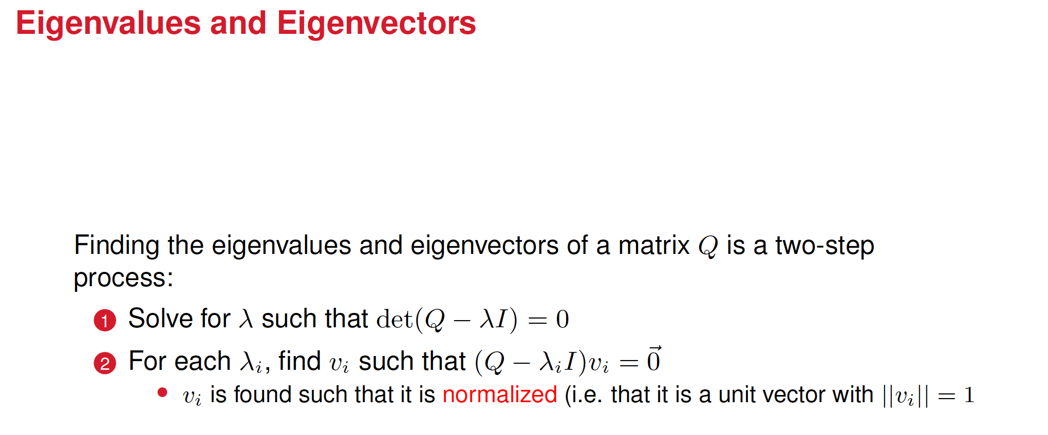

Slide 33


Slide 34







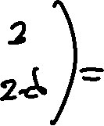







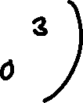
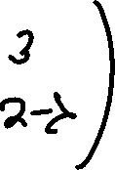





Solution

Slide 35









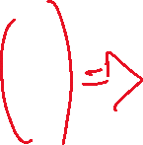




















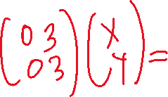






Slide 36
Step-by-Step Application of PCA
Start with centered data
Subtract the mean from each feature so the dataset has a mean of zero.
Compute the Covariance Matrix, Σ
The matrix Σ expresses how features vary with each other:
Find the Eigenvalues and Eigenvectors of Σ
The eigenvectors of Σ point in the directions of maximum variance; the eigenvectors are called the principal components.
The corresponding eigenvalues tell you how much variance is along each of those directions.
Sort by Eigenvalues
Larger eigenvalues = more variance = more "important" directions.
Sort eigenvectors by descending eigenvalues.
Project Data onto the Top k Eigenvectors
Select the top k eigenvectors (principal components) to reduce the data to k-dimensions.
New data = original data projected onto those eigenvectors

Slide 37
Step-by-Step Application of PCA
Start with centered data
Subtract the mean from each feature so the dataset has a mean of zero.
Compute the Covariance Matrix, Σ
The matrix Σ expresses how features vary with each other:
Find the Eigenvalues and Eigenvectors of Σ
The eigenvectors of Σ point in the directions of maximum variance; the eigenvectors are called the principal components.
The corresponding eigenvalues tell you how much variance is along each of those directions.
Sort by Eigenvalues
Larger eigenvalues = more variance = more "important" directions.
Sort eigenvectors by descending eigenvalues.
Project Data onto the Top k Eigenvectors
Select the top k eigenvectors (principal components) to reduce the data to k-dimensions.
New data = original data projected onto those eigenvectors

Slide 38
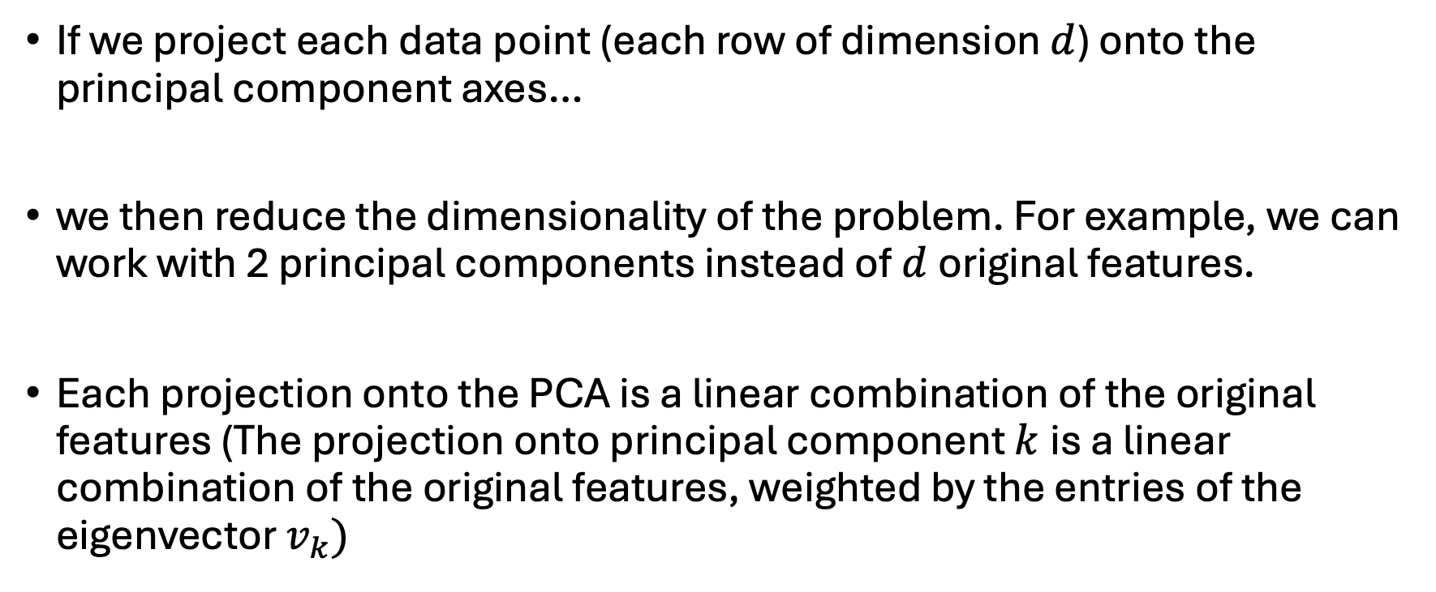
Now: dimensionality reduction
If we project each data point (each row of dimension $d$) onto the principal component axes…
we then reduce the dimensionality of the problem. For example, we can work with 2 principal components instead of $d$original features.
Each projection onto the PCA is a linear combination of the original features (The projection onto principal component $k$is a linear combination of the original features, weighted by the entries of the eigenvector $v_{k})$

Slide 39
































Percentage of variance explained

Slide 40
Examples from real research
Studying microbes in the Chesapeake Bay
Studying neutron reflectometry for polymeric materials

Slide 41
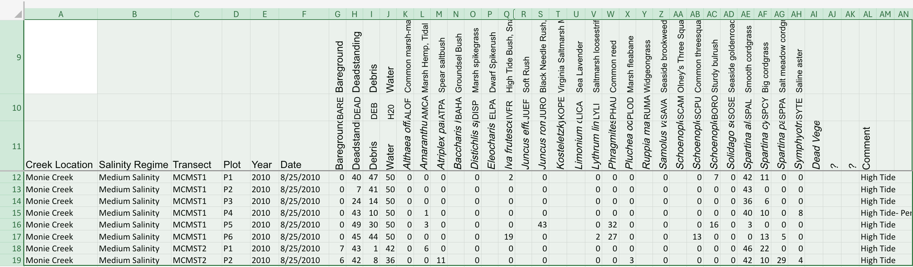

An example about microbes, soil and climate change in the Chesapeake bay

Slide 42
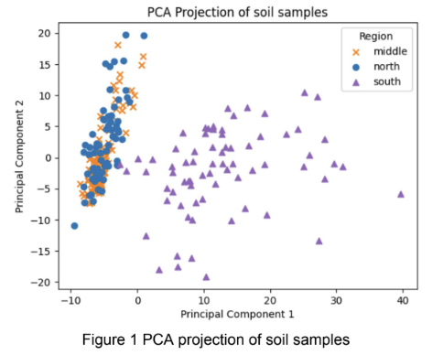
Interestingly, we found that the most abundant microbes do not contribute the most to PC1 and PC2. That means the most abundant microbes vary little from region to region.

Slide 43
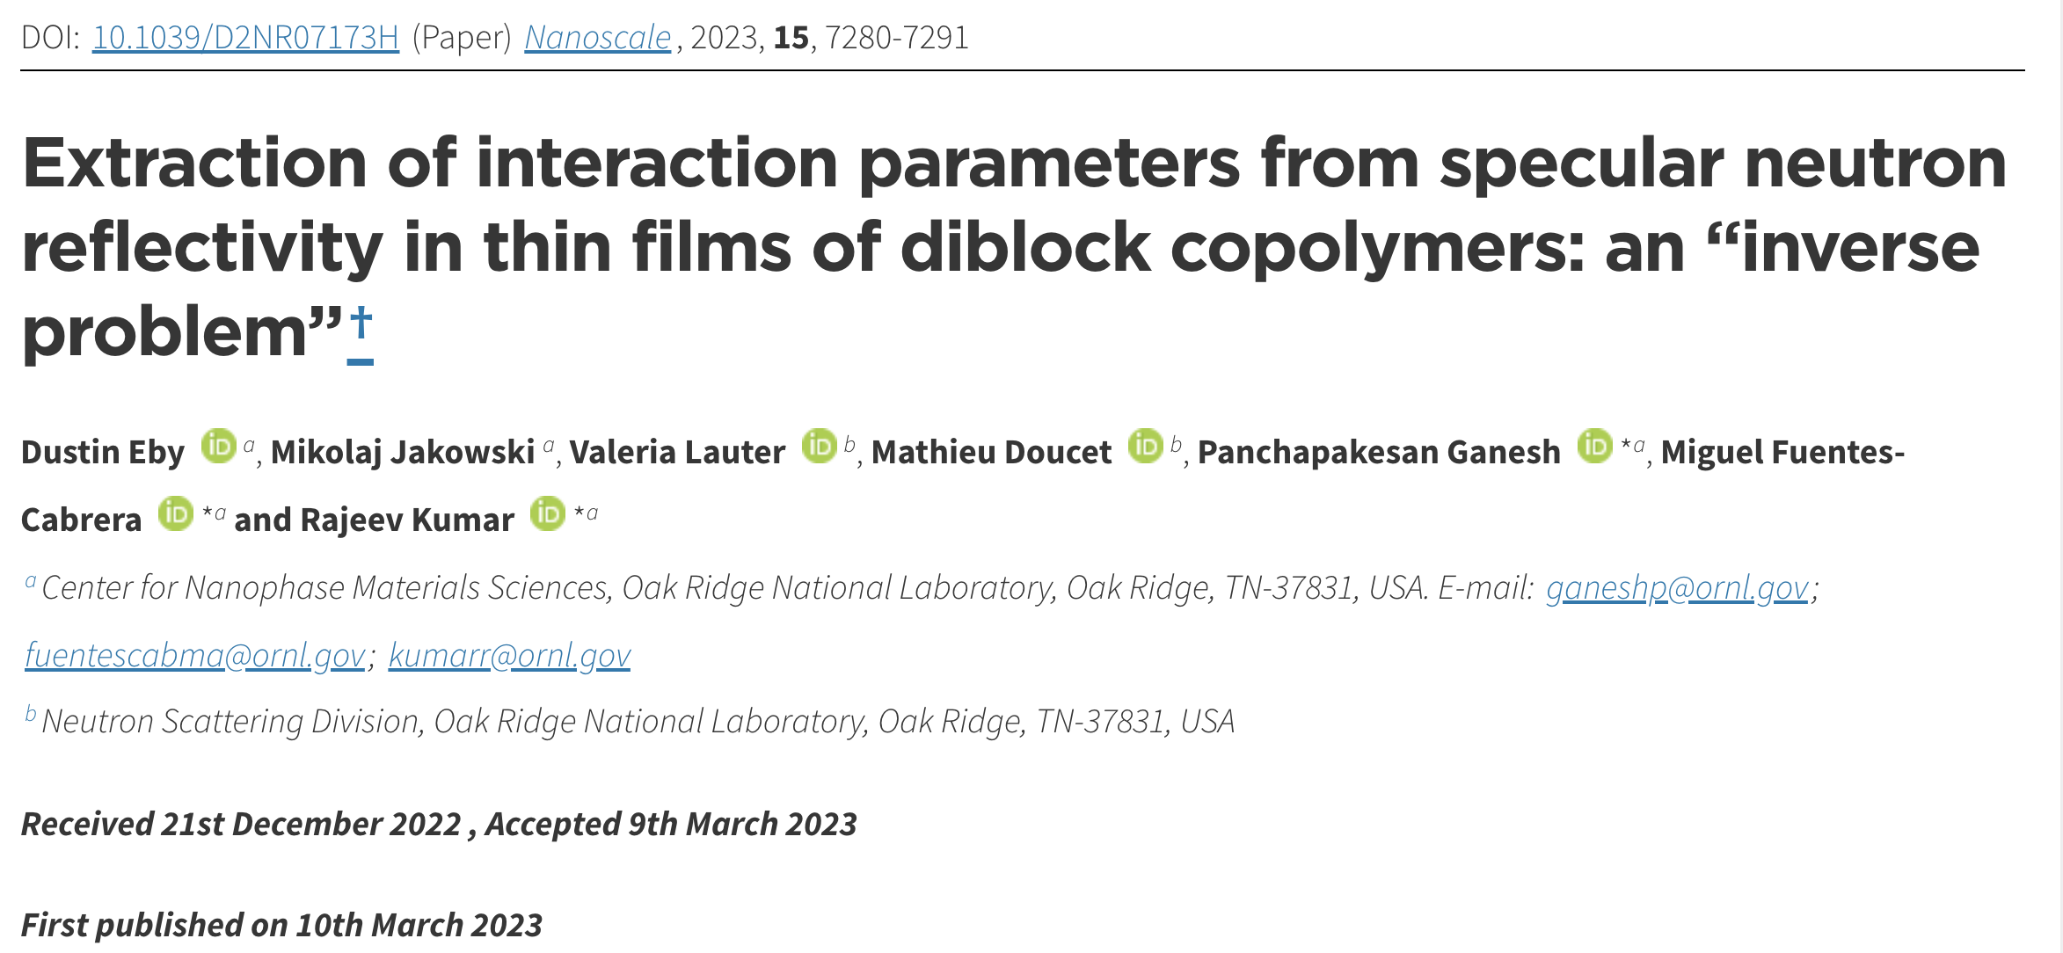
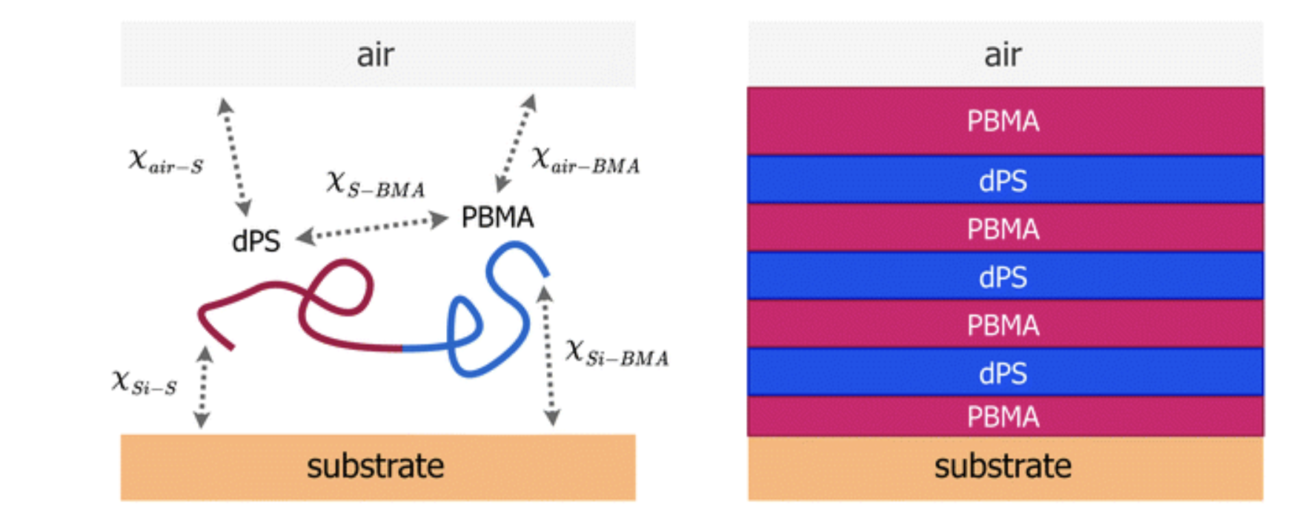

Slide 44
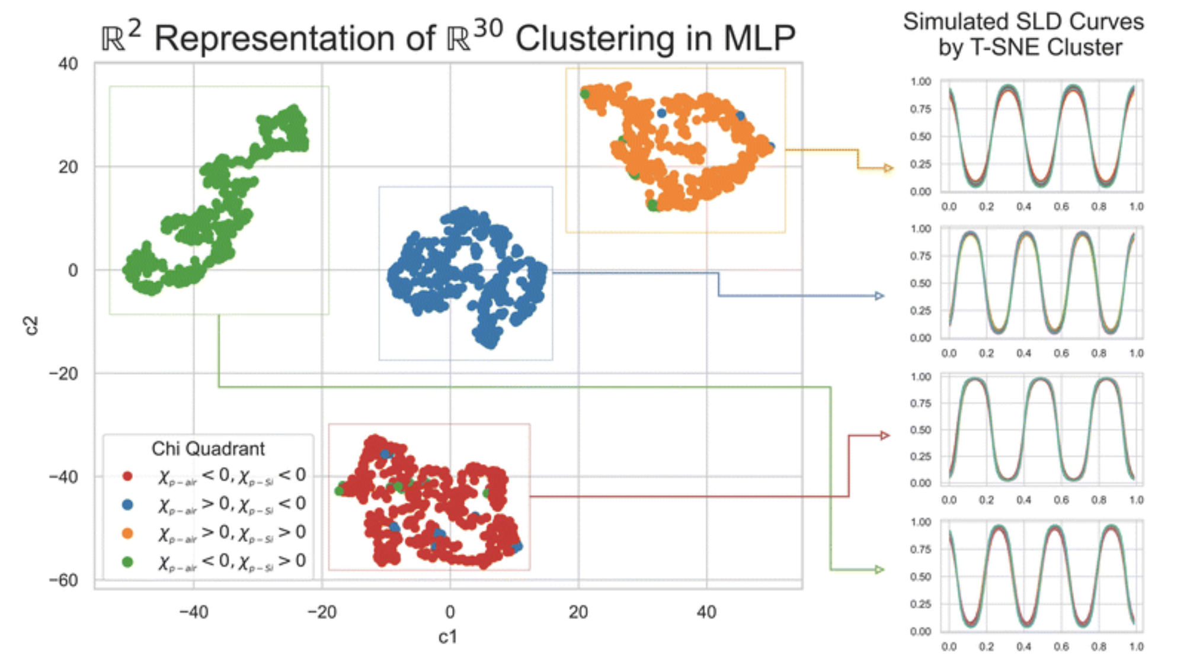

Slide 45
What happens if PCA fails
Imagine you’re listening to a symphony with background static noise:
PCA will treat whichever sound (the symphony or the static) that varies more across time as more “important.”
If the static happens to have higher variance, PCA will preserve the noise over the music

Slide 46
Alternatives to PCA analysis
In settings where variance is not the same as useful information, you'd need techniques that align components with something meaningful, like:
Linear Discriminant Analysis (LDA): maximizes separation between classes instead of just variance.
Autoencoders: learn representations that preserve information as defined by a reconstruction loss.
Mutual Information-based methods: preserve features that are more statistically dependent on labels or outcomes.

Slide 47
Video of PCA
https://www.youtube.com/watch?v=FD4DeN81ODY

